Slide 1
Getting started with SharePoint Framework
Office UI Fabric Core

Slide 2
Agenda
What is the Office UI Fabric?
How to use Office UI Fabric
Examples of Office UI Fabric Styles
Q&A

Slide 3
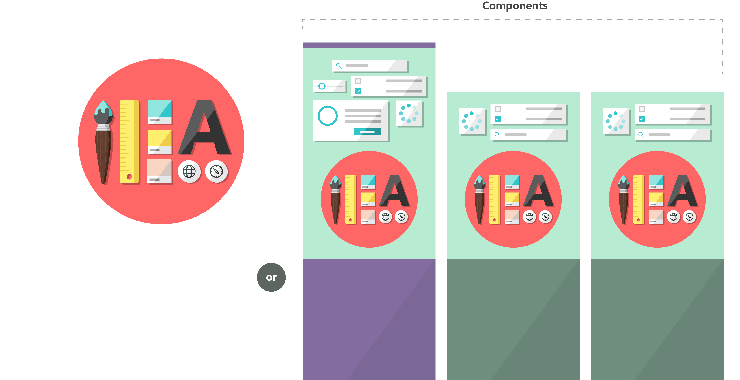

Fabric and its sub-projects
All depend on the Fabric Core, all open source
Community built
Fabric Core
Fabric React
Fabric JS
ngFabric
Fabric iOS
Core elements of the design language including icons, colors, type, and the grid
Robust, up-to-date components built with the React framework.
Simple, visuals-focused components that you can extend, rework, and build on.
Community-driven project to build components for Angular-based apps.
Native Swift colors, type ramp, and components for building iOS apps.

Slide 4
What is the Office UI Fabric?
Office UI Fabric is a responsive, mobile-first, front-end framework that you can use to apply the Office Design Language to your web experiences.
Built by Microsoft
All about styling instead of JavaScript
Integrates with other frameworks
Language support

Slide 5
Open Source
The Office UI Fabric project is developed and maintained by the OneDrive and SharePoint Design Studio in order to...
Help the development community build Office Add-ins and Office 365 web apps that integrate seamlessly with Office
Provide a point of reference for the evolving Office 365 design language that anyone can reference
Enable the community to contribute to better experiences for everyone who builds for Office

Slide 6
Monitor Releases and Contribute
Microsoft releases changes to the design language, components, and other assets frequently, and will make these updates available to the community.
If features are deprecated MS notes that in the change log, and the feature will be removed from the next major release.
Change Log
https://github.com/OfficeDev/Office-UI-Fabric/releases
Contribute In the GitHub Repository
https://github.com/OfficeDev/Office-UI-Fabric

Slide 7
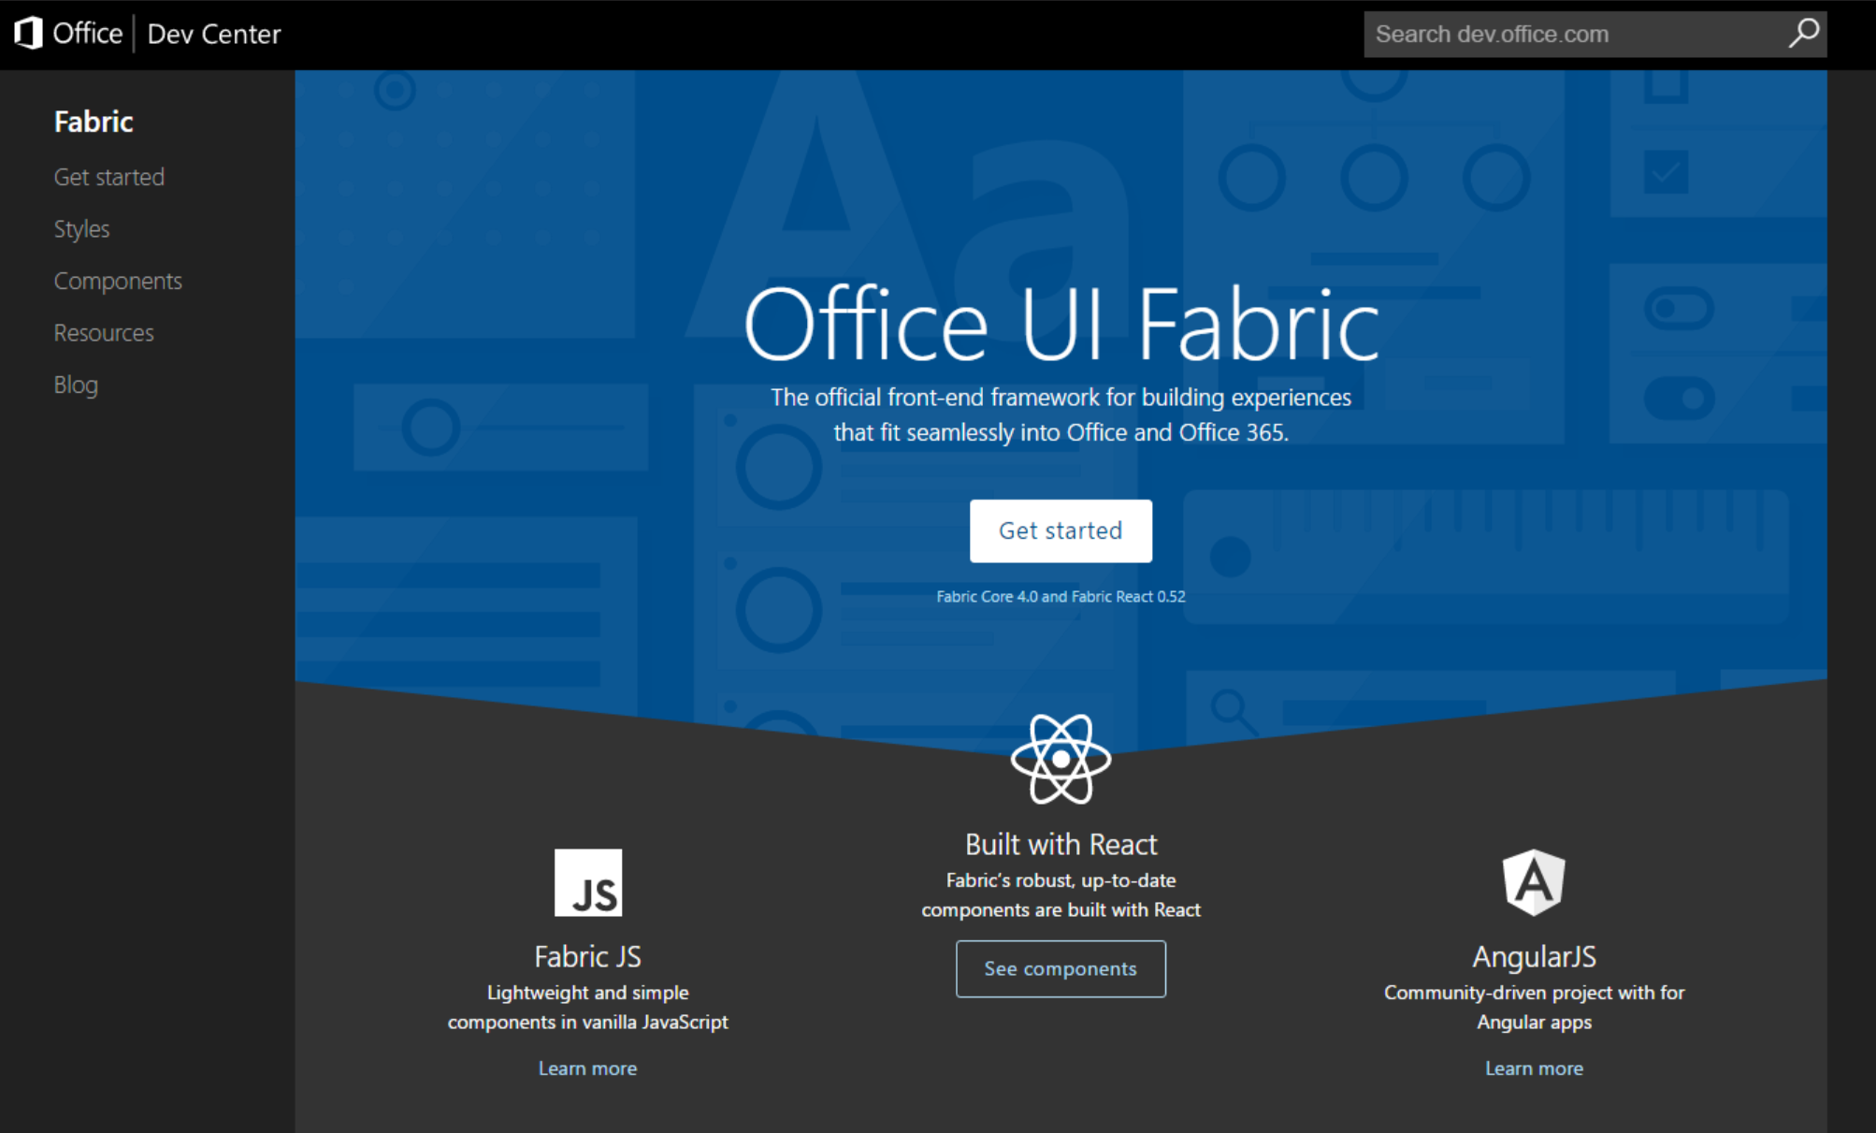
UIFabric.io
All content about Fabric is available on the new and improved site
Notes:
Everything’s on the site

Slide 8
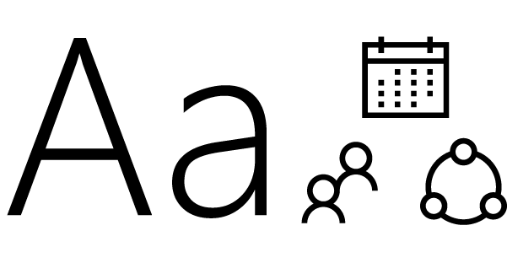
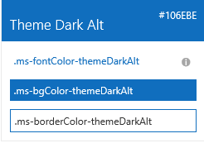

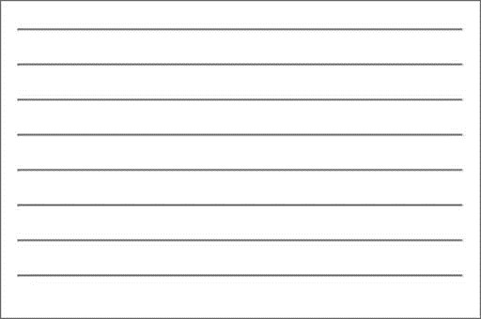

Fabric Core styling
Fonts and typography
Segoe font family + type ramp, official Office 365 iconography
Color
Official Office 365 color palette
Branded assets
Product symbols + product filetype symbols
Animations
Official Office 365 selection of easings and animations
Responsive grid
Tailored to Office 365 silhouettes
Notes:
When I talk about what we make available to developers, there are two broad categories: core and components
Core is the basic, fundamental elements of our design language that devs (MS devs included) can use to integrate apps, web parts, and custom solutions into Office/Office 365 and (of course) SP experiences

Slide 9
Styles
The Office UI Fabric provides styles to allow you to implement the following things in your applications.
Typography
Color
Icons
Animations
Responsive Grid
Localization

Slide 10
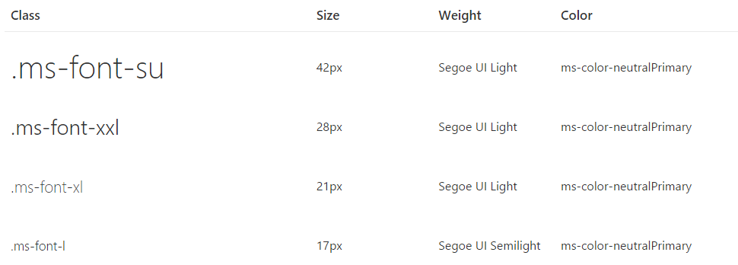
Typography
Base font classes
Fabric includes 10 base font classes that represent the type ramp for the Office Design Language. Each base class sets a default size, weight, and color.

Slide 11
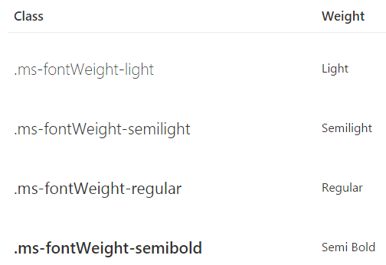
Typography
Helper font classes
Use one of several helper font classes to change the text weight.

Slide 12
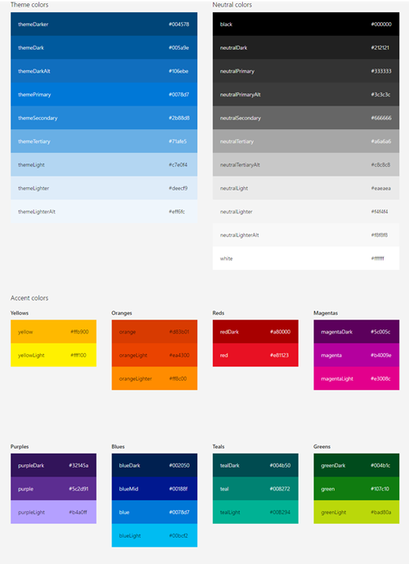
Color
Includes 9 theme colors and 11 neutral colors.
Each has helper classes for text, border, background, and hover states.
These color classes act as hooks into the Office 365 suite-wide theming system.
When the theming system is enabled and your app or Add-in is consuming the suite navigation, these classes pick up the user's chosen theme.

Slide 13
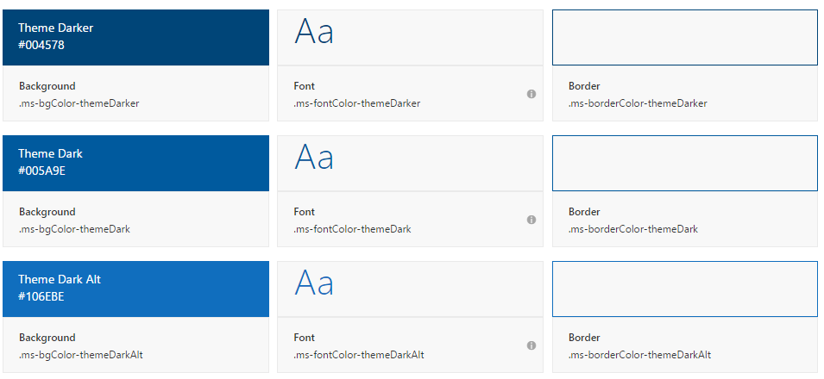
Color
Theme colors
Use theme colors in wayfinding, navigation, and key interactions like primary actions and current or selected indicators.

Slide 14
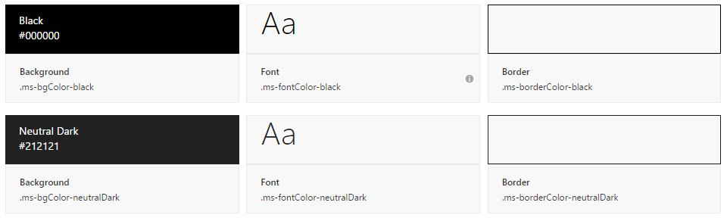
Color
Neutral Colors
Neutral colors include black, gray, and white. Use darker shades of gray for primary content, such as text and titles.
Use black sparingly for high-impact strings (labels, names) and hover states.
Use lighter shades of gray for supporting graphic elements and page areas.

Slide 15
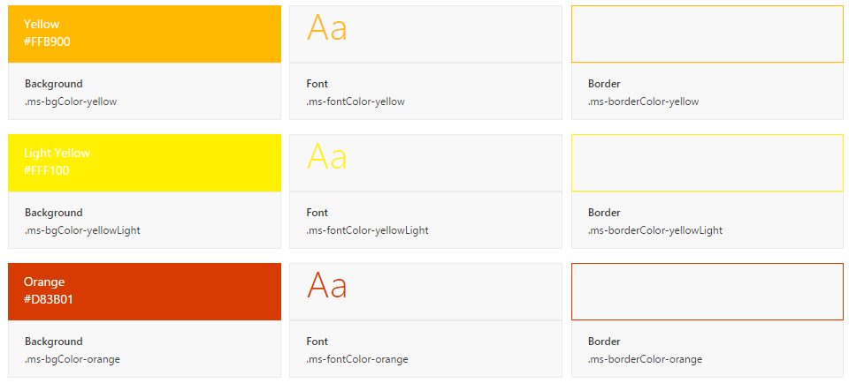
Color
Accent Colors
Fabric also includes accent colors from the Microsoft color palette.

Slide 16
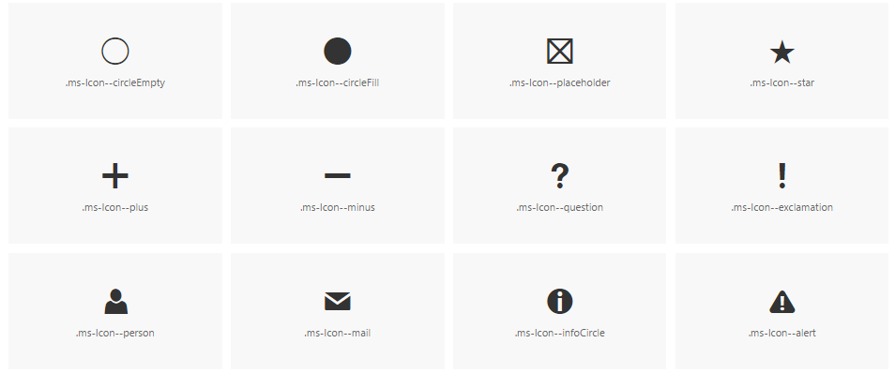
Icons
Fabric uses a custom font for its iconography.
This font contains glyphs that you can scale, color, and style in any way.
You can even flip them for right-to-left localization.

Slide 17
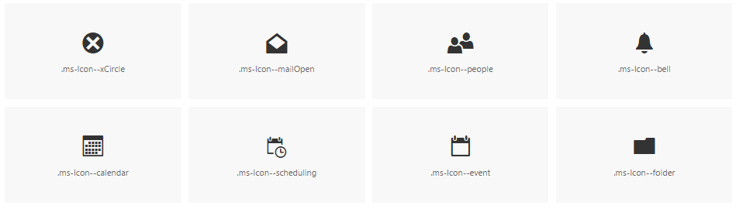
Icons
To use the icons, combine the base ms-Icon class with a modifier class for the specific icon.
<i class="ms-Icon ms-Icon--mail" aria-hidden="true"></i>
Note the aria-hidden attribute, which prevents screen readers from reading the icon. In cases where meaning is conveyed only through the icon, such as an icon-only navigation bar, be sure to apply an aria-label to the button for accessibility.

Slide 18
Animations
Use the animation library to create web experiences that integrate with Office 365.
You can use the animation CSS classes for navigation, panels, dialogs, and more.
Animations include
directionality (up, down, left, right relating to origin and completion of tasks)
enter/exit (fade in, fade out, zoom in, zoom out)
duration (speed of enter/exit relating to urgency or content type)

Slide 19
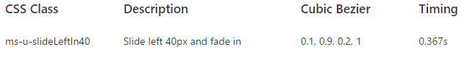
Side panel animations
When choosing a motion for side panels, consider the origin of the triggering element.
Use the motion to create a link between the action and the resulting UI.
For example, if the triggering element is on the right side of the interface, consider having the panel move in from the right.

Slide 20
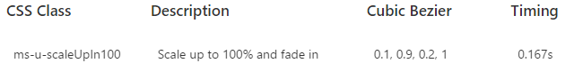
Dialog animations
When choosing a motion for dialogs, consider the origin and tone of the content.
For a warning or error dialog, a quick fade in might be appropriate.
If the dialog appears when a user chooses an item to get more information, a scale-up might be appropriate.

Slide 21
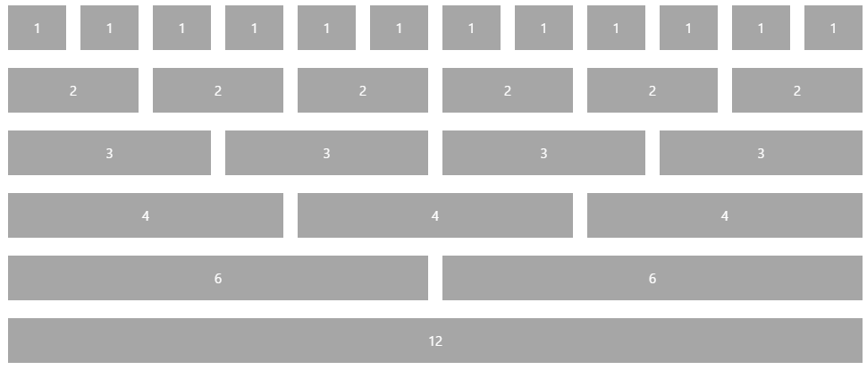
Responsive Grid
Fabric comes with a mobile-first, 12-column, responsive grid that you can use to create flexible layouts for a variety of screen sizes and device types

Slide 22
Localization
Right-to-left support
Fabric comes with an alternate CSS file for pages written in right-to-left (RTL) languages, such as Arabic and Hebrew.
This reverses the order of columns in the responsive grid, making it easy to create an RTL layout without writing additional templates.
Future versions of Fabric will also reverse some icons and provide additional helper utilities.

Slide 23
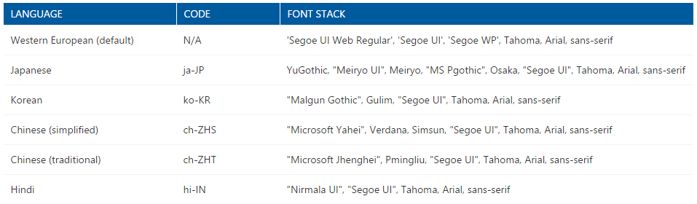
Localization
Language-optimized fonts
By default, Fabric presents all text using the Western European character set of Segoe UI.
For languages with other characters, Fabric will either serve a version of Segoe UI with a different character set or use a system font.
Fabric supports many language codes, which utilize different font stacks.

Slide 24
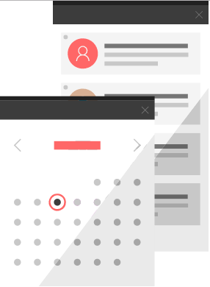
Office UI Fabric Components
Fabric's components make up the building blocks of your UI and are meant to be consumed as CSS applied to your markup.
All JavaScript is presentational to explain behavior.
Download the components from the GitHub repository
https://github.com/OfficeDev/Office-UI-Fabric

Slide 25
The Code
Office UI Fabric Developer Site
http://dev.office.com/fabric
Get Started
https://dev.office.com/fabric#/get-started
OpenSource GitHub Repository
https://github.com/OfficeDev/Office-UI-Fabric

Slide 26
Ways to obtain the Office UI Fabric
CDN <link rel="stylesheet" href="http://appsforoffice.microsoft.com/fabric/5.0.0/fabric.min.css"> <link rel="stylesheet" href="http://appsforoffice.microsoft.com/fabric/5.0.0/fabric.components.min.css"> Nuget
PM>Install-Package OfficeUIFabric
npm npm install office-ui-fabric
bower bower install office-ui-fabric
Download and install in a project
https://github.com/OfficeDev/Office-UI-Fabric/releases

Slide 27
Implementing Office UI Fabric Styles
Download the component
SearchBox component example - https://github.com/OfficeDev/Office-UI-Fabric/tree/master/src/components/SearchBox
Add the component reference to your code
<script src="SearchBox/JQuery.SearchBox.js"></script>
Initialize the component upon page load
$(".ms-SearchBox").SearchBox()
Add the component markup
<div class="ms-SearchBox"> <input class="ms-SearchBox-field" type="text"> <label class="ms-SearchBox-label"> <i class="ms-SearchBox-icon ms-Icon ms-Icon--search"></i>Search </label> <button class="ms-SearchBox-closeButton"><i class="ms-Icon ms-Icon--x"></i> </button> </div>
Notes:
This example uses the SearchBox component

Slide 28
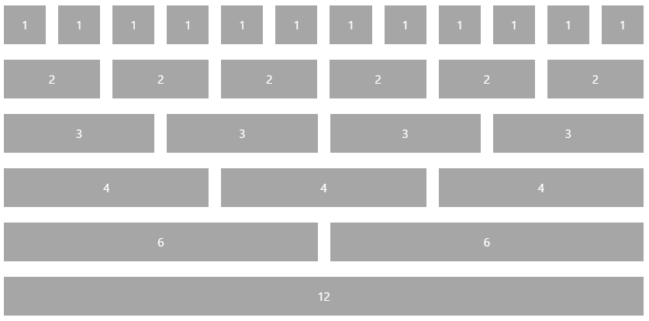
Responsive Grid
<div class="ms-Grid">
<div class="ms-Grid-row">
<div class="ms-Grid-col ms-u-sm6 ms-u-md4 ms-u-lg2">First</div>
<div class="ms-Grid-col ms-u-sm6 ms-u-md8 ms-u-lg10">Second</div>
</div>
</div>

Slide 29
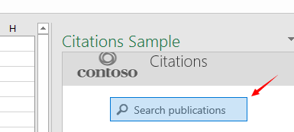
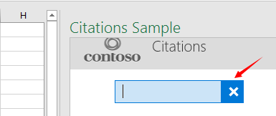
SearchBox
<div class="ms-SearchBox">
<label class="ms-SearchBox-label">
<i class="ms-SearchBox-icon ms-Icon ms-Icon--search"></i>
Search publications
</label>
<input class="ms-SearchBox-field">
<button class="ms-SearchBox-closeButton"><i class="ms-Icon ms-Icon--x"></i></button>
</div>

Slide 30
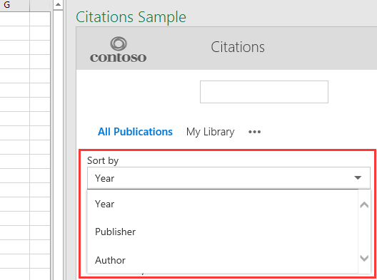
Dropdown
<div class="ms-Dropdown" tabindex="0" style="width:80%">
<i class="ms-Dropdown-caretDown ms-Icon ms-Icon--caretDown"></i>
<select class="ms-Dropdown-select">
<option>Year</option>
<option>Publisher</option>
<option>Author</option>
</select>
</div>

Slide 31
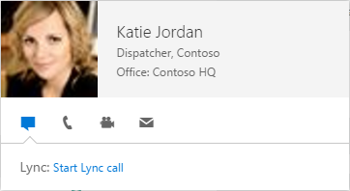
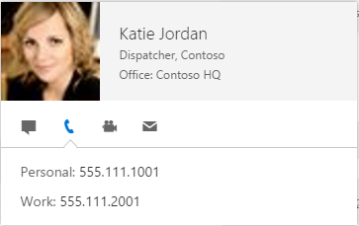
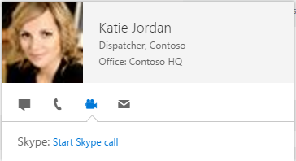
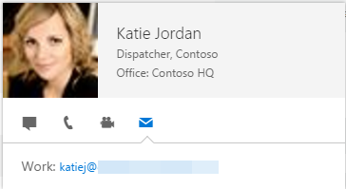
Persona Card
Bind Data With Server Side or Client Side Code
Property Management Server Side example - https://github.com/OfficeDev/Property-Inspection-Code-Sample
<div class="details-block">
@foreach (var item in Model.members)
{
<div class="content-row">
<div class="ms-Persona ms-Persona ms-Persona--square ms-Persona--xs">
<div class="ms-Persona-imageArea">
<img class="ms-Persona-image" src="@Url.Action("UserPhoto", "Photo", new { userId = item.id })">
</div>
<div class="ms-Persona-details">
<div class="ms-Persona-primaryText">
@item.displayName
</div>

Slide 32
DEMO
Office UI Fabric Core – what is it and how to use it?

Slide 33
Summary
What is the Office UI Fabric?
How to use Office UI Fabric
Examples of Office UI Fabric Styles
Q&A

Slide 34

Sharing is caring…
Code samples and solutions
Reusable components
Guidance documentation
Monthly community calls
SharePoint Framework
SharePoint add-ins
Microsoft Graph
Office 365 APIs
http://aka.ms/SharePointPnP

Slide 35

Q&A

Slide 36


